Slide 1

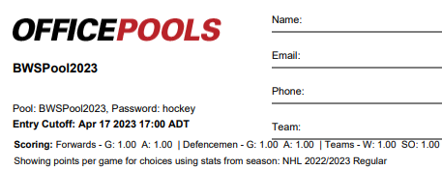
$10 Entry
Contact: avery.briggs@bwstrailers.com
$20 pays for the pool website.
Prize: 1st 50%, 2nd 35%, 3rd 15%
https://www.officepools.com/invite/classic/m/K44ACJA

